Slide 1
UNIT TESTING IN ANGULARJS
Dhananjay Kumar
@debug_mode
http://debugmode.net

Slide 2
Important points
Tweet your experience about webinar using the hashtag #Infragistics or tag @infragistics to win cool goodies from us.
Recording of webinar will be available by Wednesday on Infragistics blog.
You will also get Email notification for uploaded recording
We welcome all of you to take advantage of a FREE 30 Day Trial by downloading the product at: http://www.infragistics.com/products/ultimate/download
Please reach out to us at Sales-India@infragistics.com for any follow up questions you may have. We welcome the opportunity to assist you.
http://www.infragistics.com/community/blogs/dhananjay_kumar/default.aspx

Slide 3
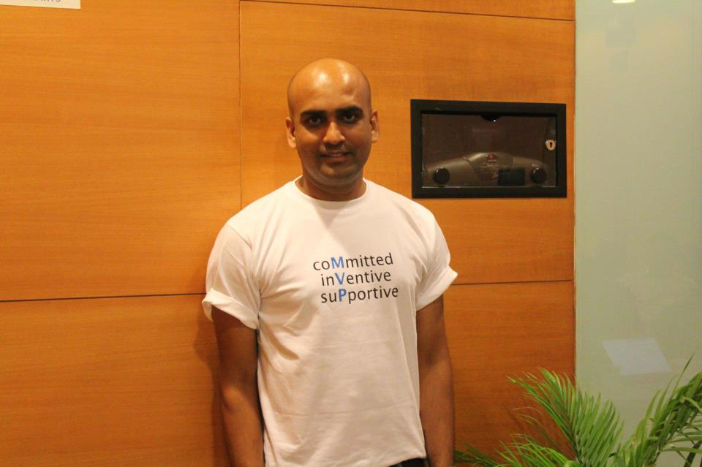
I am Dhananjay Kumar
Infragistics Developer Evangelist
7 times Microsoft MVP
@debug_mode
dkumar@infragistics.com
http://debugmode.net

Slide 4
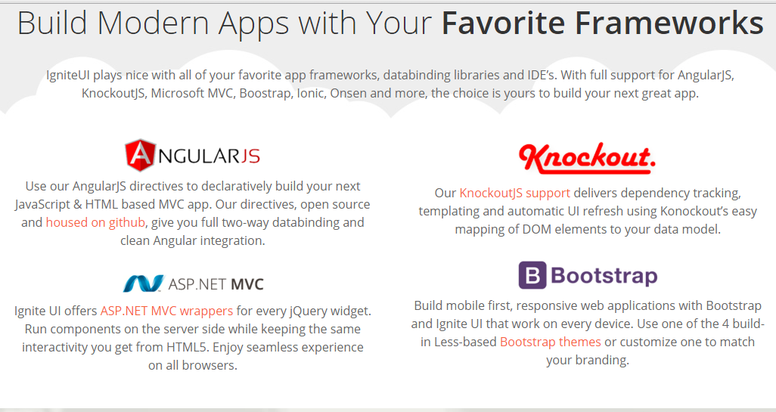
Ignite UI = ig jQuery library
http://www.igniteui.com

Slide 5
Agenda
Unit Testing
Setting up Jasmine
Writing test for JavaScript function
Writing test for AngularJS
Installing karma
Running test using karma
Running test for AngularJS Controller
Running test for AngularJS Service
Running test for $http

Slide 6
Running Tests
I am using Visual Studio 2015. You can use any editor of your choice
Installing dependencies using NPM
Install NodeJS globally
Writing Test using Jasmine
Running Test using karma

Slide 7
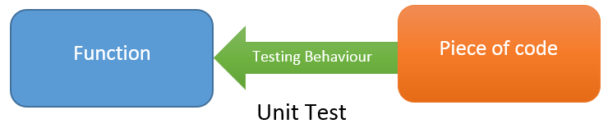
What is Unit Test
Unit Test is a piece of code which tests behaviour of a function or class.
Unit Tests are written by the developers.

Slide 8
Why Unit Test ?
Unit Testing reduces the level of bugs in production code.
Unit Testing saves you development time.
Unit Testing saves time in debugging later
Automated Unit tests can be run as frequently as required with different set of input
A good Unit Tests are a form of documentation
Unit Testing forces you to confront the problem head on
Unit Tests allows you to make big changes to code quickly
Unit Tests help you really understand the design of the code you are working on. Instead of writing code to do something, you are starting by outlining all the conditions you are subjecting the code to and what outputs you'd expect from that.

Slide 9
We will use
Jasmine
Karma
ngMock
Chrome

Slide 10
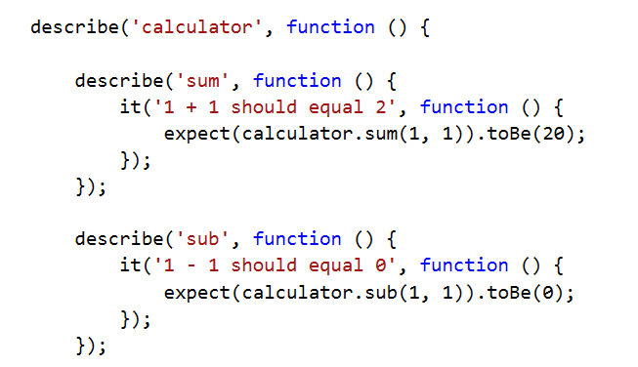
What is Jasmine
Jasmine is a Behavior Driven Development testing framework for JavaScript
t does not rely on browsers, DOM, or any JavaScript framework
Thus it's suited for websites, NodeJS projects, or anywhere that JavaScript can run
http://jasmine.github.io/2.0/introduction.html

Slide 11
What is Karma
Karma is a JavaScript test runner created by the AngularJS team
Karma provides helpful tools that make it easier to us to call our Jasmine tests whilst we are writing code
Karama is a JavaScript command line tool that can be used to spawn a web server which loads your application's source code and executes your tests
Karma can be configured to run against various browsers.
Karma is executed on the command line and will display the results of your tests on the command line once they have run in the browser
Karma is a NodeJS application, and should be installed through npm
http://karma-runner.github.io/0.13/index.html

Slide 12
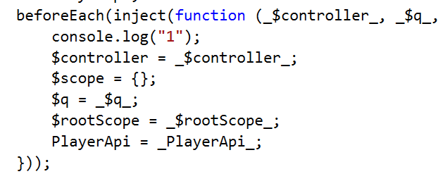
What is ngMock
The ngmock module provides support to inject and mock Angular services into unit tests
The ngMock also extends various core ng services such that they can be inspected and controlled in a synchronous manner within test code
The ngMock module is in the namespace angular.mock
https://docs.angularjs.org/api/ngMock

Slide 13
Demos
JavaScript based Calculator App adhering TDD approach and running test in browser
Unit testing AngularJS filter and running test in browser
Configuring Karma Test Runner
Running Test using Karma
Unit Test Controller
Unit Test Services
Unit Test $http

Slide 14
Q& A ?

Slide 15
What Infragistics can offer you?
We welcome all of you to take advantage of a FREE 30 Day Trial by downloading the product at: http://www.infragistics.com/products/ultimate/download
Please reach out to us at Sales-India@infragistics.com for any follow up questions you may have. We welcome the opportunity to assist you.
For technical queries send me email at dkumar@infragistics.com

